Slide 1


BROWN FORMAN CORPORATION
Inventory Management System

Slide 2

Contents
Project Overview
01
02
Database Design
03
Demo of Shiny Application

Slide 3

Project Overview - Goal of Platform
3A Visions
Assist in operating distribution with fewer disruptions, save costs and human work elimination
A real –time database of information capable of connecting many retail outlets across the country
Accurately handle the product inventory and track the order and shipment status

Slide 4
Project Overview - Functions
Record
Maintain
Track
Produce
Update
Recording each product’s information in a warehouse
Maintaining the information on all products in the inventory
Tracking the stocks, order status, and shipment status
Producing the final reports of orders and shipments
Updating the information and reduction of product obsolescence and decay

Slide 5
Project Overview - Benefits
50%
Save 30% of the time on
inventory management
70%
35%
Save 20% of the time on producing reports based on order and completed date
20%
30%
Decrease 70% of human error
Save 35% of the time on
tracking orders and shipments
Save 50% of the cost of wage

Slide 6

Project Overview - Potential users
Inventory
Managers
Inventory
Workers
Store
Managers
Receiving and recording new goods when it is delivered or shipped out by examining various suppliers, logging daily deliveries, and assessing new shipments
Keeping track of purchases and deliveries, and assessing new shipments
Controls stock and sales at the store level
Notes:
Add images

Slide 7
Database Design – Entities
01
Manufacturer
Another company that may provide items to the warehouse
Example: Rolfson
01
02
Store
02
A retailer that has ordered or might order products
Example: Hamill-Howe
03
Order
07
The transaction is associated with the sale of one product and is identified by an order_id from sales or accounting. Example: 4001
03
Entities
04
Shipment
The transaction is associated with one order to a store and is identified by a shipment_id from sales or accounting.
Example: 10001
04
06
Product
05
A type of liquor or wine or beer in the warehouse that may be ordered by stores or supplied by suppliers.
Example: Budweiser Magnum Beer
05
06
Order Line
It serves to link many to many relationship between product and order
07
Stock
Record each SKU that the warehouse has for different products Example: There are 170 bottles of Budweiser Magnum Beer in stock

Slide 8
Database Design – Business Rules
01
Each manufacturer supplies one to many products and each product is supplied by one manufacturer
02
Every order contains one product and one product is released by one order
03
Each order is shipped to one store and each store places zero to many orders
04
Each shipment consists of one to many orders and each order if fulfilled by one shipment
05
Each product is maintained in one stock and one stock maintains one to many products
Notes:
What are some of the approaches you learned in class that was used in the design?
Why do you have such an E-R diagram design
How do you transformed your E-R diagram to tables
How do you normalized your tables.
What were some of the challenges you encountered while creating sample data?

Slide 9
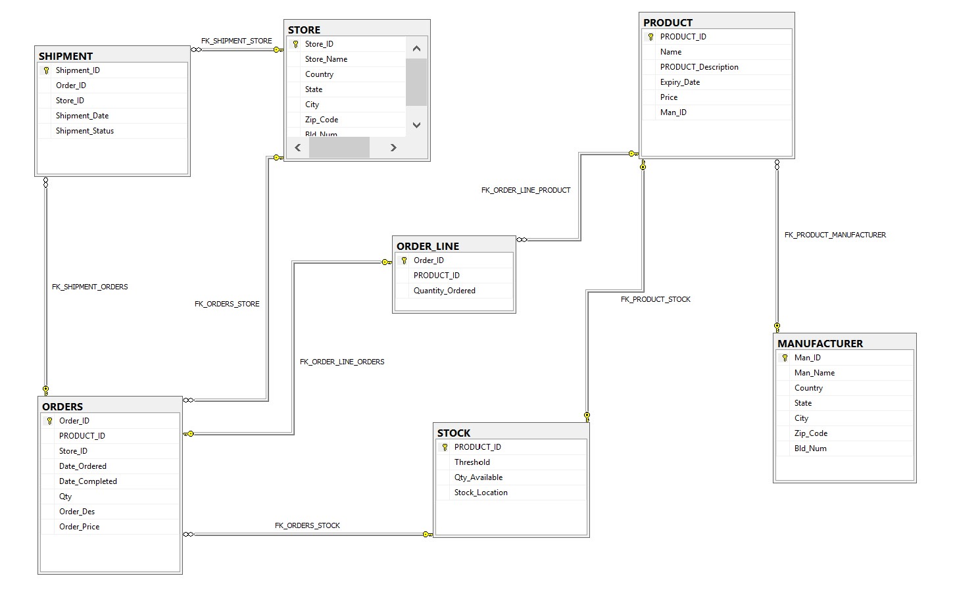
Database Design – SSMS ERD Diagram

Slide 10
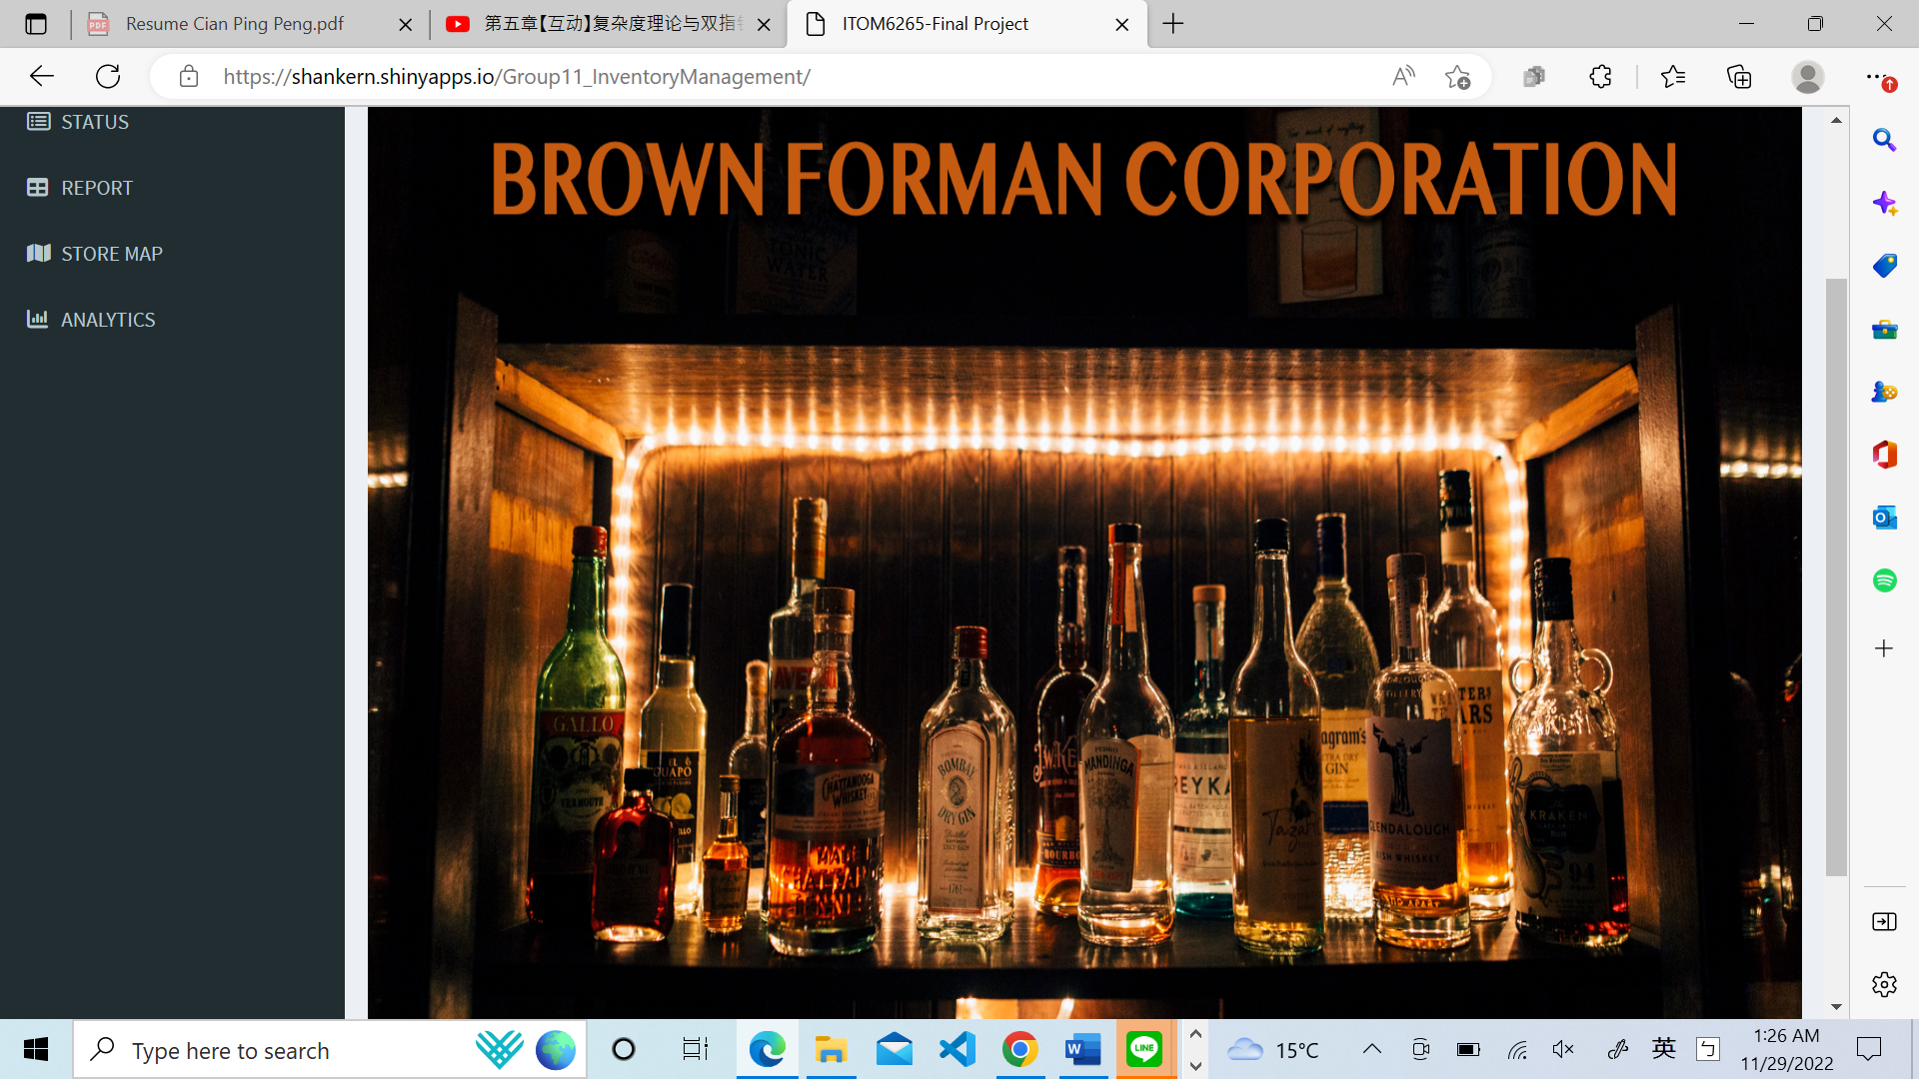
Demo of Shiny Application
BROWN FORMAN CORPORATION
Inventory Management System
Product
Add/ Search/ Update/ Delete
Status
Search by order ID and order status
Report
Search by date type and range
Store Map
Search by store state
Analytics
Produce monthly sales reports for each category and stock status.

